Slide 1
VIMA: Robot Manipulation with Multimodal Prompts
Wenyao Zhang
wenyao.zhang@connect.umac.mo
2024.8.21

Slide 2
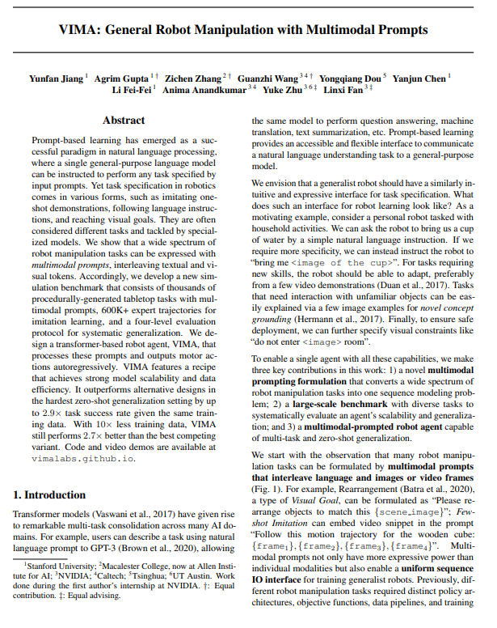

Slide 3
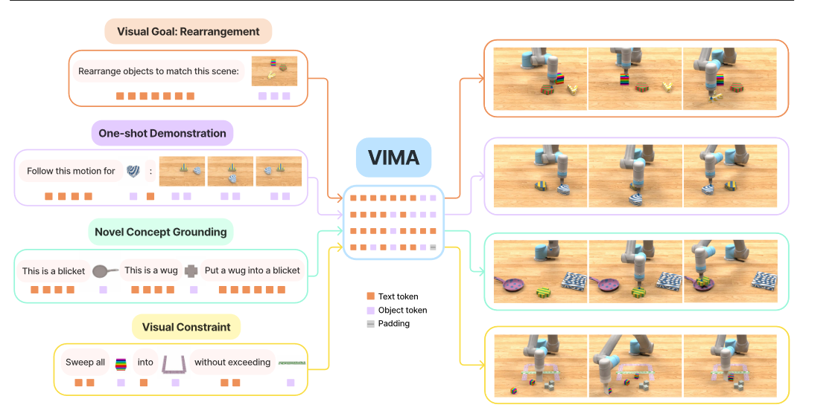
Multimodal prompts for task specification

Slide 4
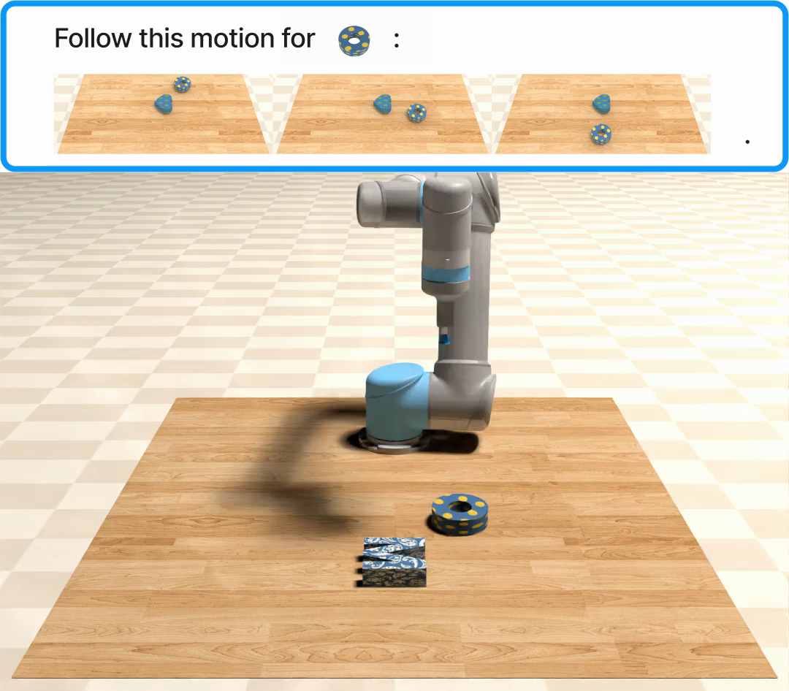

Slide 5
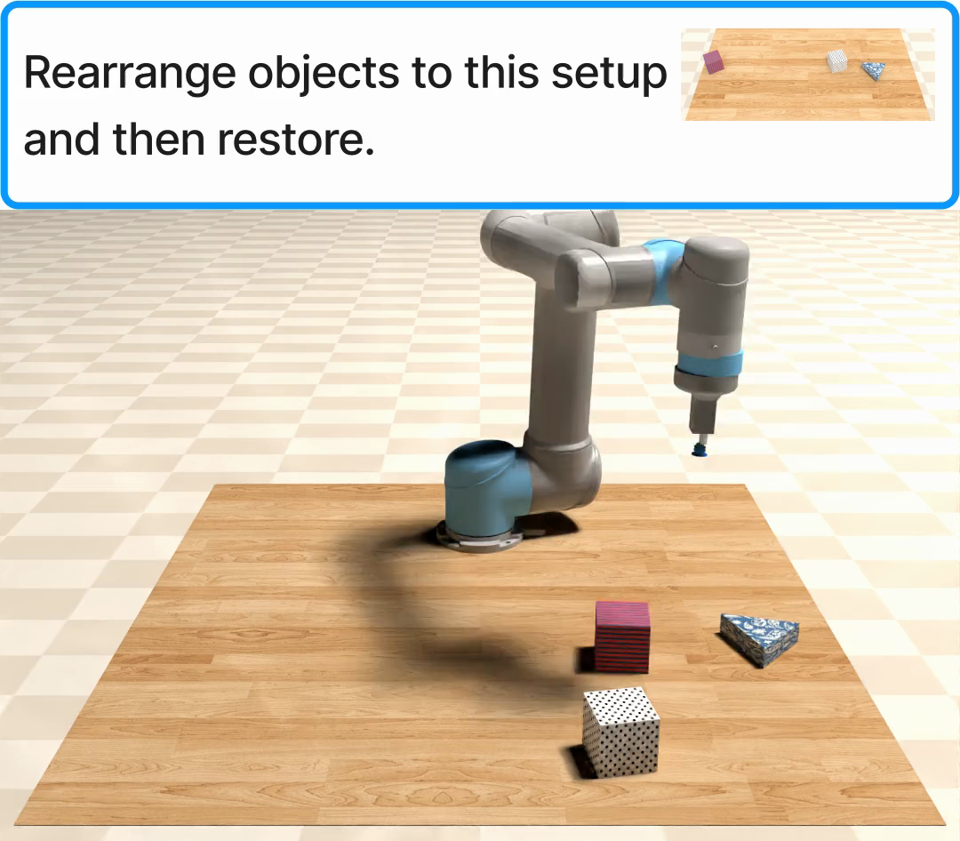

Slide 6
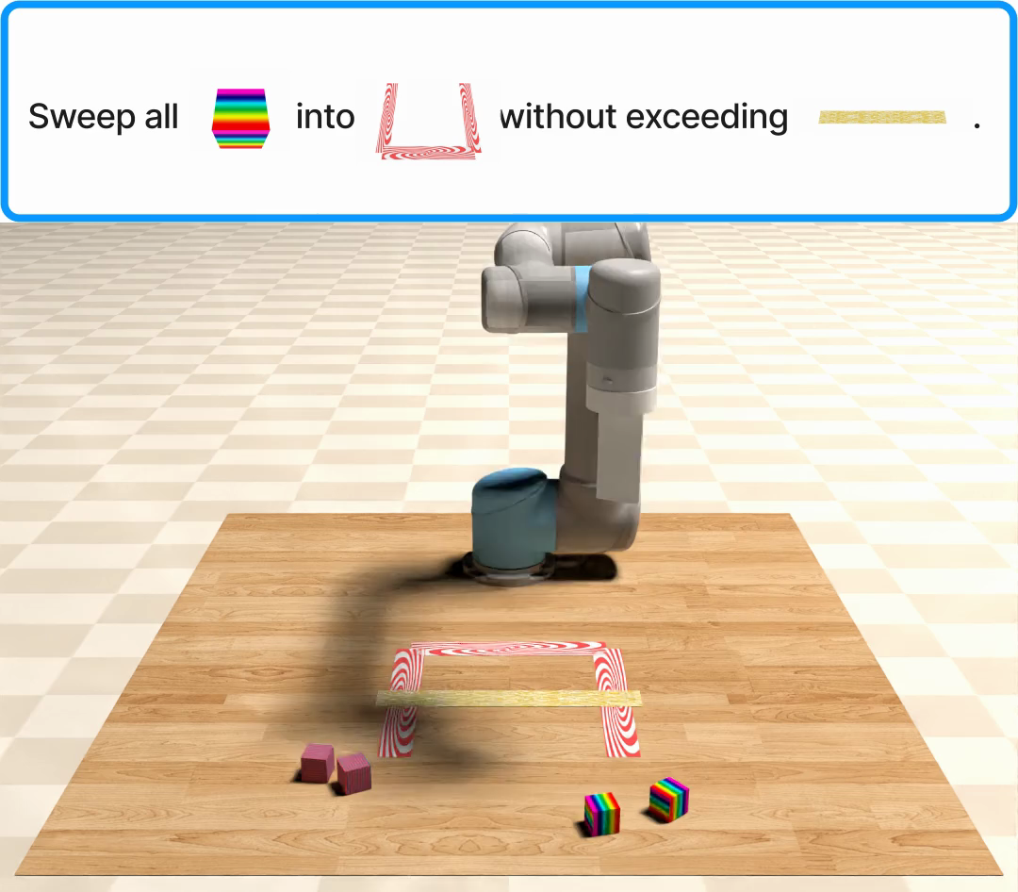

Slide 7
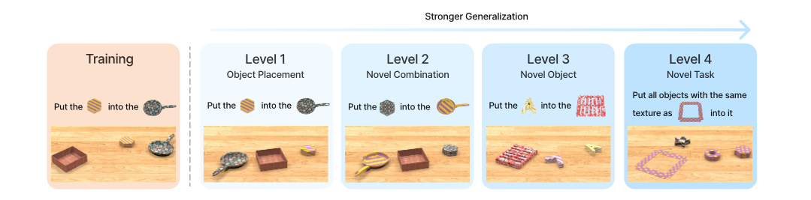
Evaluation Protocol in VIMA-BENCH

Slide 8
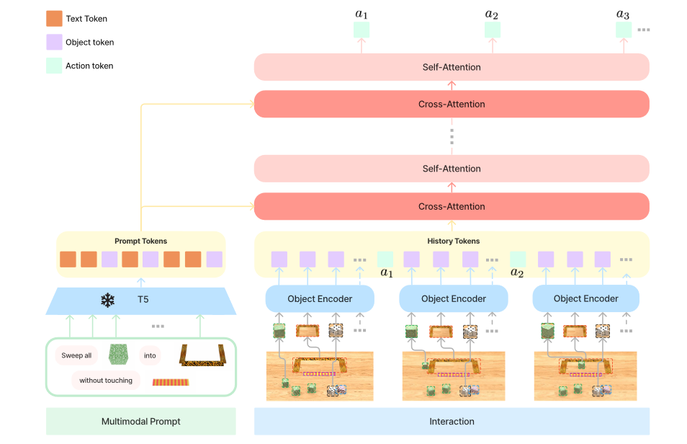
VIMA Architecture

Slide 9
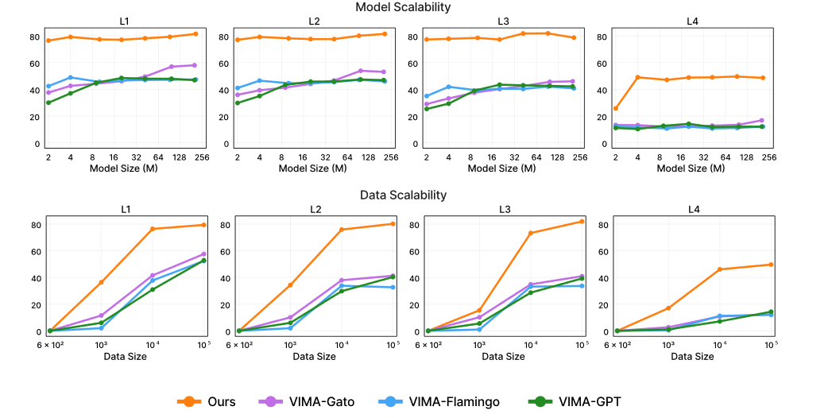
Scaling model and data

Slide 10
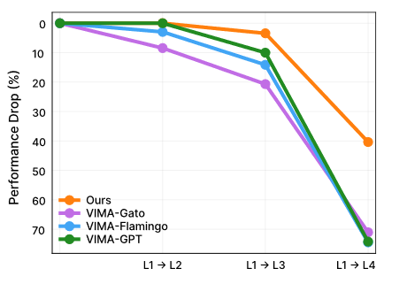
experiments
VIMA incurs much less performance drop than baselines as we evaluate on progressively harder settings.

Slide 11
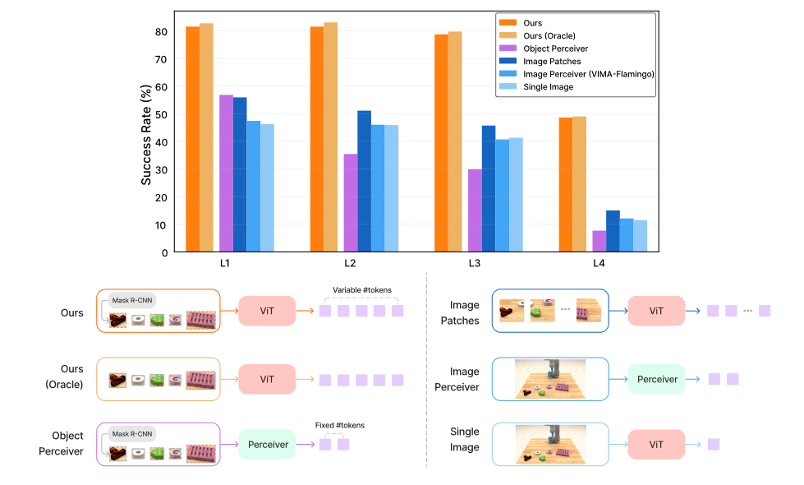
Ablation on visual tokenizers

Slide 12
Thank You!
Wenyao Zhang
tel:65869860
Wenyao.Zhang@connect.umac.mo

